Slide 1
Kwik Mart Database Management
100+ Supermarket Chain across United States

Slide 2
OUR TEAM
Rachana Anil
Bishal Agrawal

Slide 3
Data generation & Triggers
Overview
ERD & Schema
Stored Procedures & Functions
Views
Data Insights

Slide 4
Overview
We walk in and walk out of a supermarket regularly but never stop to think how it is working so efficiently.
In this project, we built a system that manages inventory, employee details, warehouses, customers and their purchases, to name a few.
We tried to make our system as robust as possible!

Slide 5
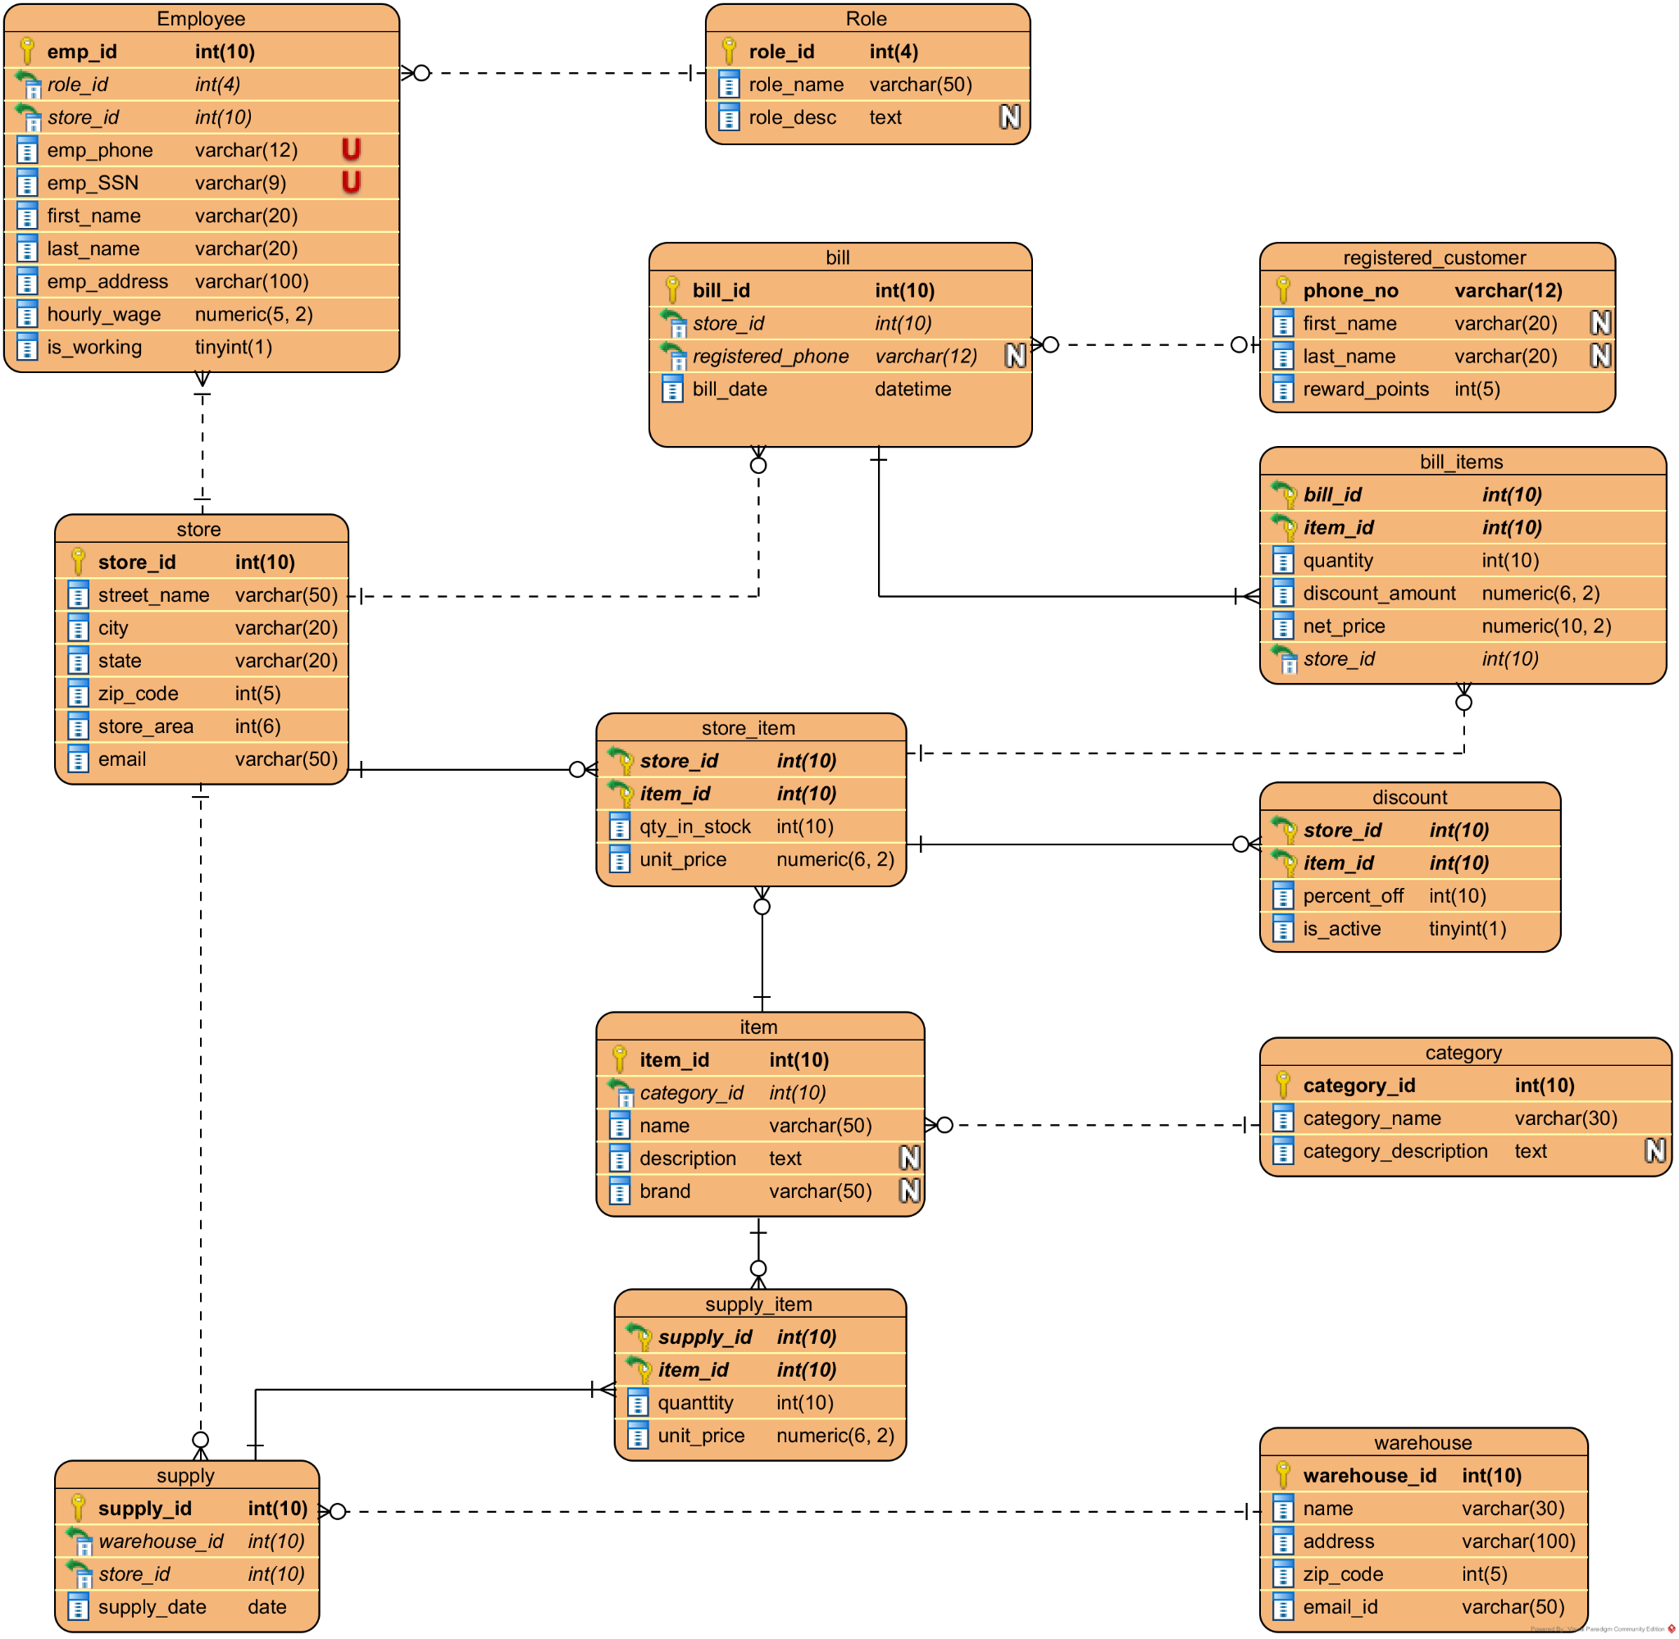
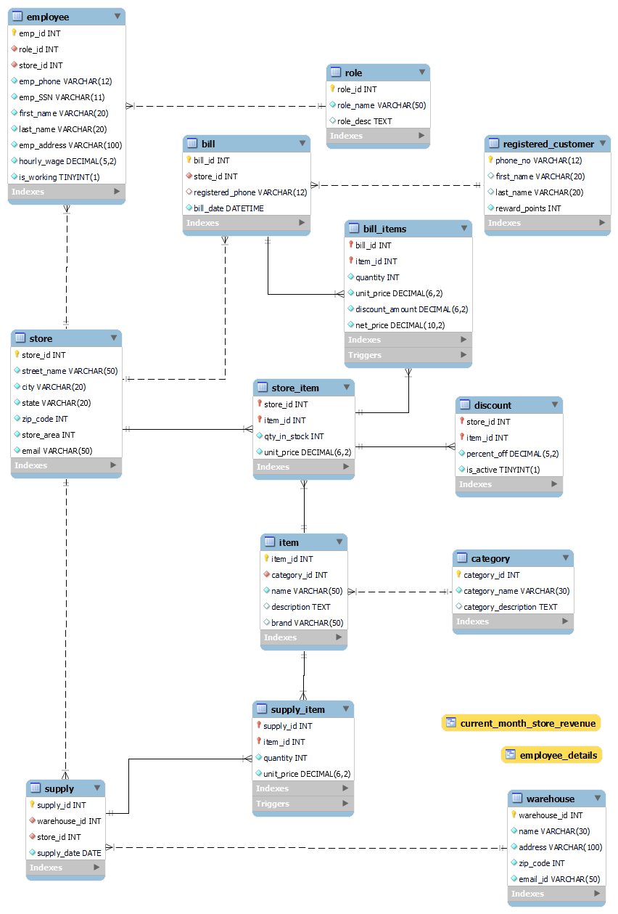
ERD & Schema

Slide 6
Data Generation
Triggers
Mockaroo
Excel Manipulations on generated data
Items and Categories from a CSV file which was available online
Our triggers had to be defined before any data insertion to keep our DB consistent.
Warehouse supply => Store inventory
Customer purchases => Store inventory

Slide 7
Stored Procedures
Add item to cart
Generate Bill
Item checker
A cashier can use this procedure to add the items purchased by the customer while billing
Returns items purchased, quantity of each item, total cost, discount, net cost
Gives the list of 5 closest stores where an item is available.

Slide 8
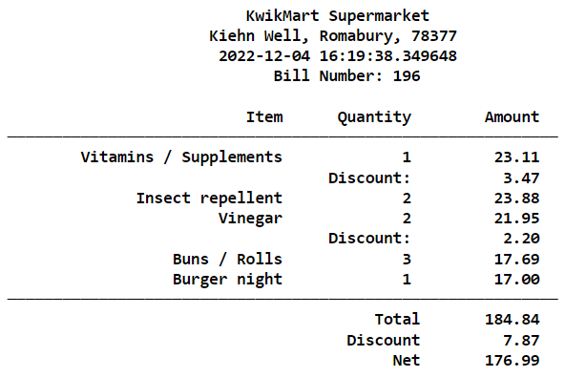
Stored Procedure- Generate Bill

Slide 9
Functions
Create New Bill
Store Revenue
Used by a cashier to create a new bill when a customer lines up at a billing counter.
Cashier asks for a mobile number and generates a bill.
Used by the store manager to track the revenue generated within a given range of dates
Overall Revenue
Update Discounts
Used by the board of Directors and CEO to strategize based on revenues from all stores
Used by employees to add or remove discount on items at store.

Slide 10
Views
Employee Details
Monthly Revenue
Provides the employee details and the store they’re working in. Leaves out critical information like SSN, Salary, and CEO details
Used by stakeholders to check current month’s revenue along with the previous days revenue for all stores.

Slide 11
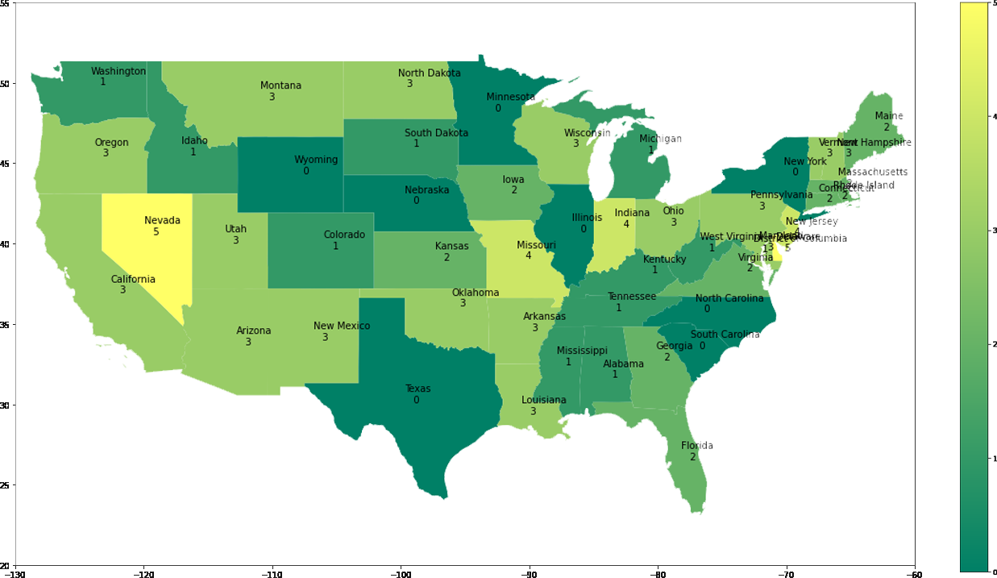
DATA INSIGHT- Number of Stores

Slide 12
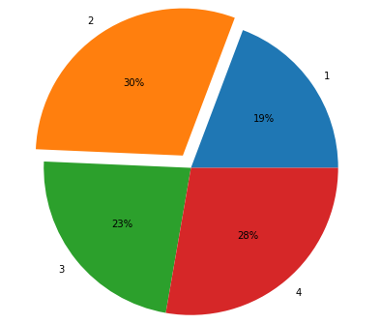
DATA INSIGHT- Quarterly Revenue

Slide 13
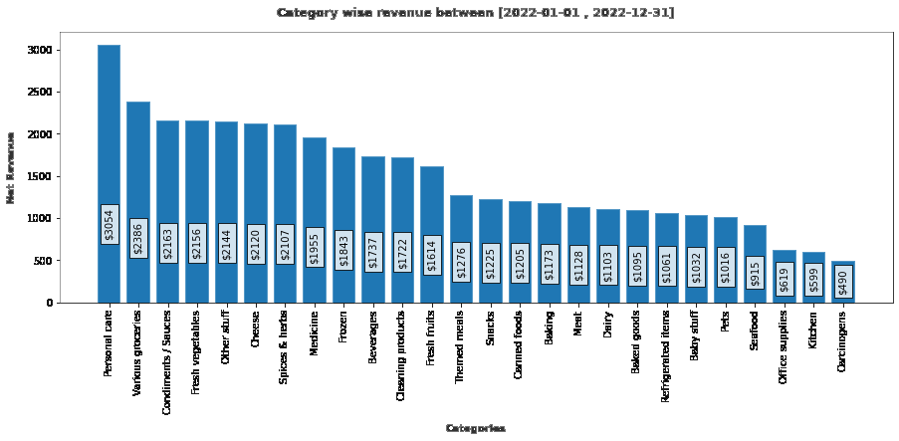
DATA INSIGHT- Revenue by category

Slide 14
DEMO

Slide 15
THANKS!
THANKS!
Any Questions?

